Slide 1
File Operations in Python

Slide 2
Introduction to File Operations
So far in any python program the standard input is coming from keyboard & output is shown on monitor.
Hence we can save the data using variable or any other data structure temporarily only (In RAM)
So to read files from hard disk & to modified then and later to save & access them from disk directly we need to go through the file operations in python language .

Slide 3
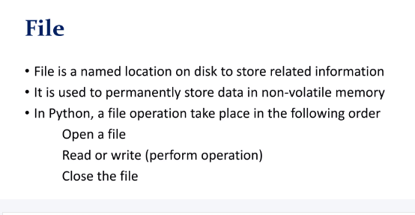
Introduction to File Operations

Slide 4
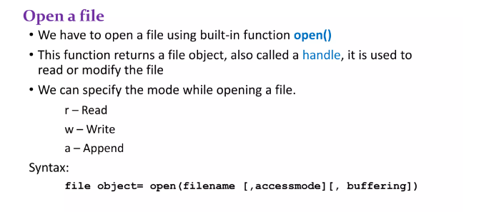
Introduction to File Operations

Slide 5
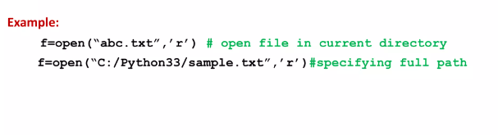
Introduction to File Operations

Slide 6
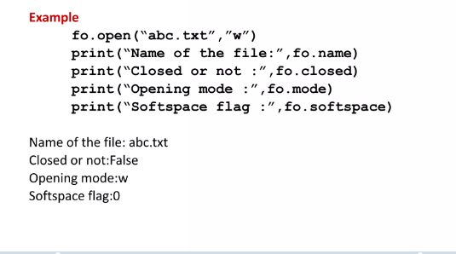
Introduction to File Operations

Slide 7
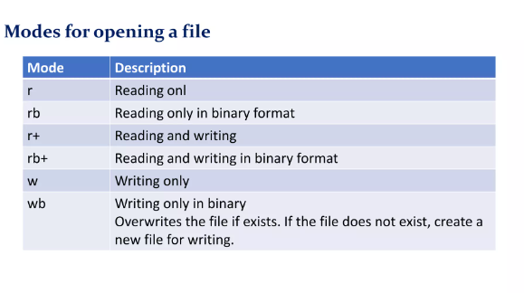
Introduction to File Operations

Slide 8
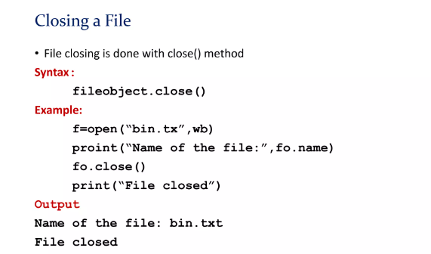
Introduction to File Operations

Slide 9
Introduction to File Operations
Following are some of the functions in Python that allow you to read and write to files:
read() : This function reads the entire file and returns a string
readline() : This function reads lines from that file and returns as a string. It fetch the line n, if it is been called nth time.
readlines() : This function returns a list where each element is single line of that file.

Slide 10
Introduction to File Operations
write() : This function writes a fixed sequence of characters to a file.
writelines() : This function writes a list of string.
append() : This function append string to the file instead of overwriting the file.

Slide 11
Introduction to File Operations
The read() method returns the given number of bytes from the file. Default value is -1 which means the whole file is to be read.
file= open(“abc.txt", "r") print(file.read())
file= open(“abc.txt", "r") print(file.read(10))

Slide 12
Introduction to File Operations
readline() method: This method is used to read the file one line at a time till the​ \n character is found in the file. It checks \n at the end of the line.
file = open(“abc.txt", "r") print(file.readline())
file = open(“abc.txt", "r") print(file.readline())
print(file.readline())

Slide 13
Introduction to File Operations
readlines() method: ​This method is used to read the whole file but line by line. It checks the file by each line that is returned.
This method return all lines in the file, as a list where each line is an item in the list object form.
file = open(“abc.txt", "r") print(file.readlines())

Slide 14
Introduction to File Operations
file = open(“abc.txt", "r") print(file.readlines(35))
Here 35 is the hint parameter.
Where the number of bytes returned exceed the hint number, no more lines will be returned. Default value is -1, which means all lines will be returned as a list in output.

Slide 15
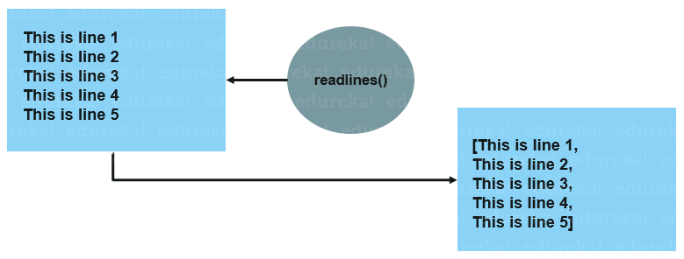
Introduction to File Operations

Slide 16
Introduction to File Operations
To create a new file in Python, use the open() method with following parameters:
"x" - Create - will create a file, returns an error if the file exist with the same name.
file = open(“abc.txt", "x")

Slide 17
Introduction to File Operations
To perform the write to an existing file with some name, we must add a parameter to the open() function like –
"a" - Append - will append the content to the end of the file
"w" - Write - will overwrite the content to any existing content

Slide 18
Introduction to File Operations
file= open(“abc.txt", "w") file.write("the content is deleted , this is new content ") file.close()
file = open(“abc.txt", "a") file.write("Now the file has more content appended with previous one") file.close()

Slide 19
Introduction to File Operations
The writelines() method writes the content of a list to the file.
Where the texts will be inserted depends on the file mode the file is being write.
"a": The texts will be inserted at the current file position, default at the end of the file.
"w": The file will be emptied before the texts will be inserted at the current file position, default.

Slide 20
Introduction to File Operations
file.writelines(list)
file = open("demofile3.txt", "a/w") file.writelines(["\nHello Python ", "\nHello section-17"]) file.close()

Slide 21
Q.1
Create a text file with your name
Open the file in write mode
write 3 lines one by one to you files
Append 5 lines in a single statement.
Read the first 50 characters if your file
Read the first five line of your file
Read all the lines of your file not exceeding 150 characters

Slide 22
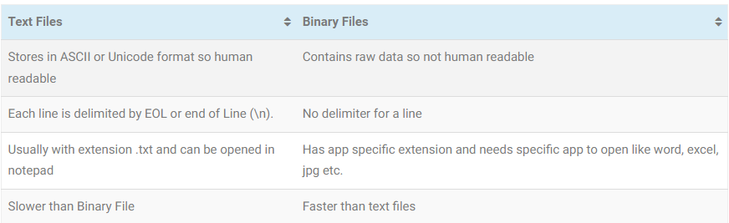
Types of File ..

Slide 23
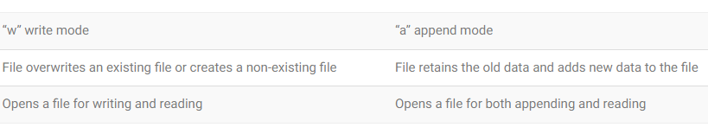
Write and Append mode

Slide 24
Q.1
Display all the lines in a file with no of lines read.
Consider a file yourname.txt
Open the file in read mode
Set count as 0
Read lines using readlines()
Use for loop and count no of lines in file
Print line and line number in file
Close the file

Slide 25
Q.2
Take a file yourname.txt
Read lines using readlines()
Use for loop to traverse all lines
Use if condition to check “go” in lines
Use lines.tolower().count (“go”) > 0 to count occurrence in file.
Increment count to +1
Close the file

